Slide 1
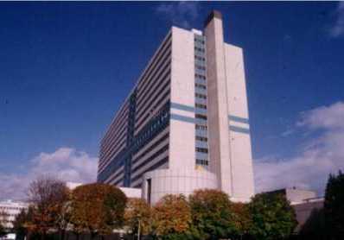
Benign tumors of the liver: Tips and Tricks
Laurence BARANES, Pierre ZERBIB, Frédéric PIGNEUR, Alain LUCIANI, Alain RAHMOUNI
CHU HENRI MONDOR, CRETEIL, FRANCE

Slide 2
Aims
To know the role of imaging techniques for the diagnosis of benign liver nodules
To know when to biopsy a benign liver nodule

Slide 3
Principles
Common situation
Need a definitive diagnosis
High specificity
Sensitivity ?
New developments in MRI
Hepatospecific contrast agents

Slide 4
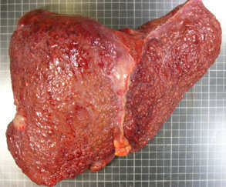
Chronic liver disease ?
yes
HCC ?
No
Single nodule
Multiple nodules
Metastases ?
Multiple benign nodules?
Hemangioma
Focal nodular hyperplasia
Cysts
Adenoma

Slide 5
yes
HCC ?
No
Single nodule
Multiple nodules
Metastases ?
Multiple benign nodules?
Hemangioma
Focal nodular hyperplasia
Cysts
Adenoma
Chronic liver disease ?

Slide 6
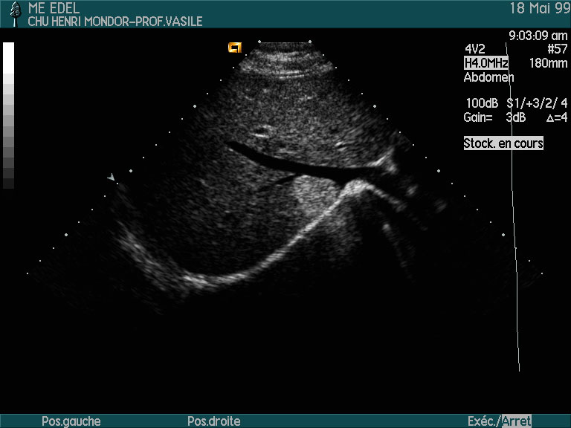
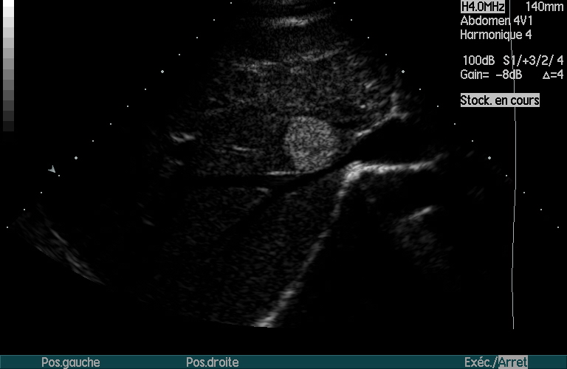
Liver hemangioma
Diagnosis based on US if
No history of cancer
Normal liver tests
Less than 3 nodules
Typical features
Hyper-echoic
Homogeneous
Posterior acoustic enhancement
No doppler signal

Slide 7
Liver hemangioma
What to do if there are atypical features?
Constrast enhanced US
MRI
→ Typical enhancement: arterial, peripherical, discontinuous, centripetal enhancement, uniform filling on the venous phase

Slide 8
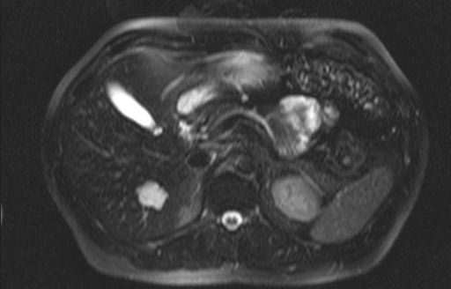
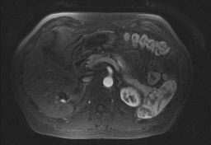
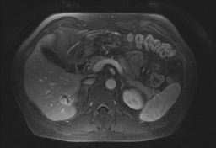
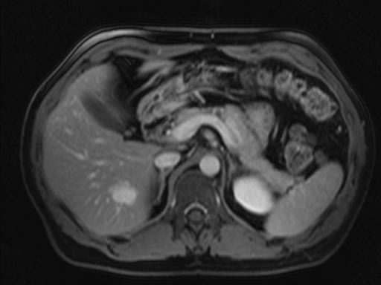

Slide 9
Liver hemangiomas
Capillary or fast flow hemangioma
16% of all hemangiomas
Often small lesions
Enhancement: arterial, intense, homogeneous similar to the aortic enhancement during all phases
Common association with an arterioportal shunt: transient arterial perilesional enhancement

Slide 10
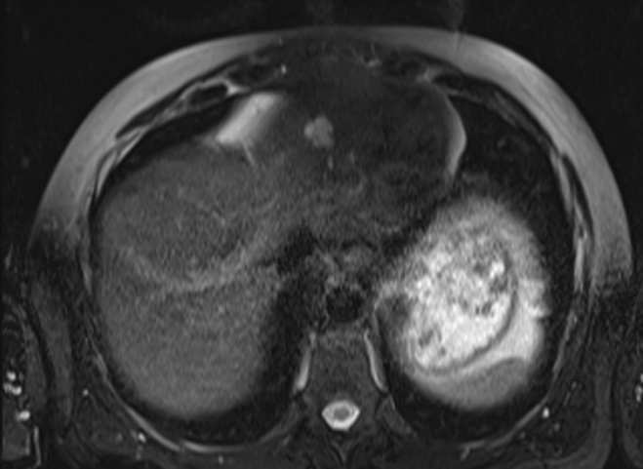
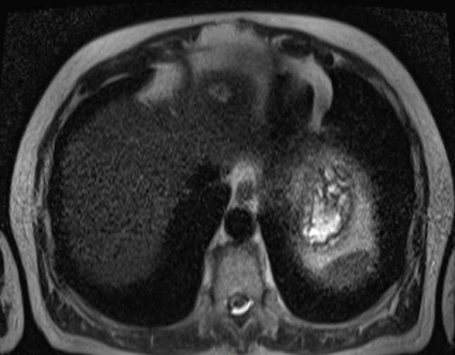
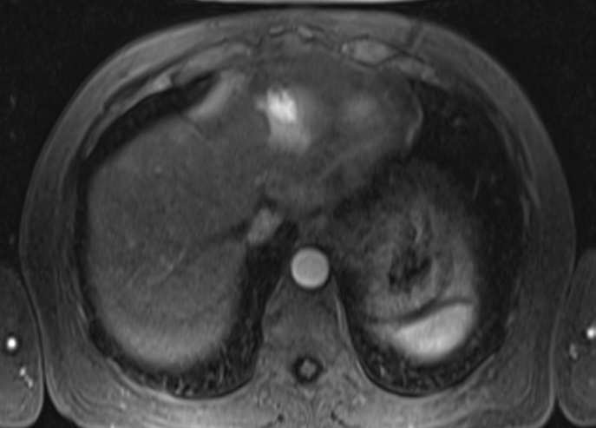
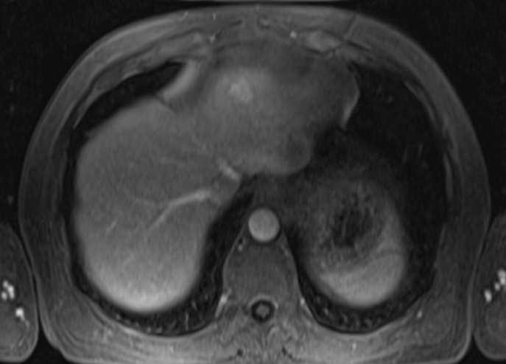

Slide 11
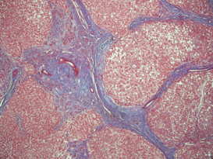
Focal nodular hyperplasia: MRI typical features
Signal:
Homogeneous
Slighty hyperintense on T2
Slightly hypointense on T1
Hyperintense central scar on T2
Enhancement :
Homogeneous (central scar excepted)
Arterial
Late enhancement of the central scar
No capsule
Se = 74%
Sp = 100%
T2
IV-
Mathieu et al. Lancet. 1998 Nov 21;352(9141):1679-80

Slide 12
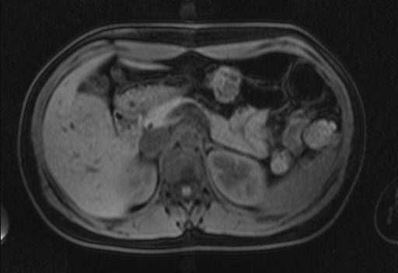
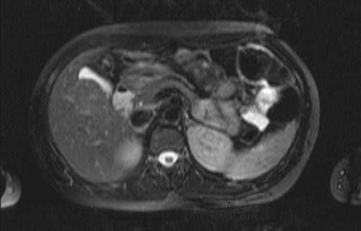

Slide 13
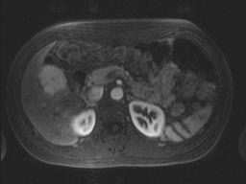
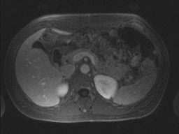

Slide 14
Focal nodular hyperplasia: atypical features and traps
Nodules <3 cm often display atypical features
Which explain the low sensitivity (75%)
What to do?
→ Technical optimization
CEUS
MRI with injection of hepatospecific contrast agent
b=800 s/mm2
Nguyen BN, Flejou JF, Terris B, Belghiti J, Degott C. Focal nodular hyperplasia of the liver: a comprehensive pathologic study of 305 lesions and recognition of new histologic forms. Am J Surg Pathol. 1999 Dec;23(12):1441-54.
b=100 s/mm2
Notes:
Exemple à trouver

Slide 15
Focal nodular hyperplasia: atypical features and traps
CEUS
Characteristics | FNH | Adenoma
Centrifugal enhancement Centripetal enhancement Mixed enhancement | 74-91% 2-7% 7-19% | 16% 47-53% 32-37%
b=800 s/mm2
b=100 s/mm2
Notes:
Exemple à trouver

Slide 17
Focal nodular hyperplasia: atypical features and traps
MRI with injection of hepatospecific contrast agent
Blood Vessel
Bile duct
extracellular distribution
hepatocellular captation via OATP1 receptor (same as bilirubin)
biliary excretion via MRP2 transporter.
OATP1
Hepatocyte
MRP2
Bilirubin
OATP1 = Organic Anion Transporting Polypeptide 1
MRP2 = Multridrug Resistance associated Protein 2
Planchamps et al. Mol Pharmacol 2007
Pastor et al. Radiology 2010

Slide 18
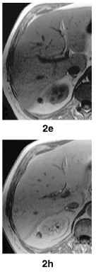
Focal nodular hyperplasia: atypical features and traps
MRI with injection of hepatospecific contrast agent
Gd-BOPTA - Gadobenate Dimeglumine
Focal nodular hyperplasia enhancement on biliary phase
No enhancement of adenoma
Se 97% / Sp 100%
Grazioli et al. Radiology 2005; 236:166-177

Slide 19
Focal nodular hyperplasia: atypical features and traps
MRI with injection of hepatospecific contrast agent
T1 IP
T1 OP
T2 FS
T1 VIBE IV-
T1 VIBE arterial
T1 VIBE portal

Slide 20
Focal nodular hyperplasia: atypical features and traps
MRI with injection of hepatospecific contrast agent
T1 IP
T1 OP
T1 VIBE
T1 FS

Slide 21
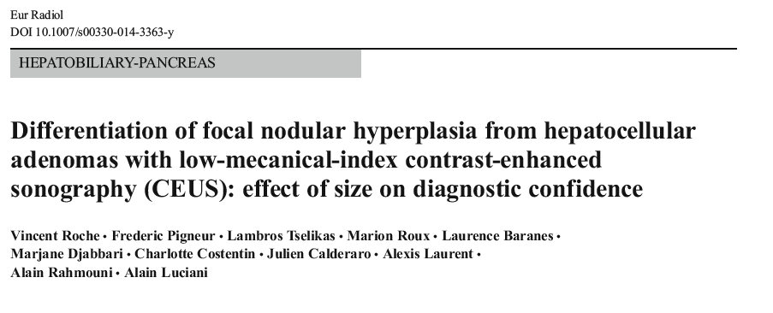
Focal nodular hyperplasia: atypical features and traps
How to choose the diagnostic modality?
Importance of the size of the nodule on CEUS
Local experience (Henri Mondor)
n=40 patients
FNH or HCA with CEUS and MRI-HBP
 | CEUS
Sensitivity % For all lesions(n=43) For lesions > 35 mm(n=13) For lesions ≤ 35 mm(n=30) | 67,7 7,7 93,3
Specificity % For all lesions For lesions > 35 mm For lesions ≤ 35 mm | 100 100 100

Slide 22
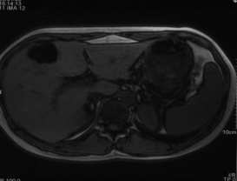
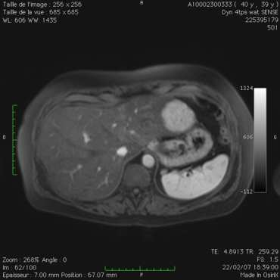
Adenoma
Genotype/phenotype classification | % | Characteristic | Histology | Immunohistochemistry | HCC transformation
HNF1α mutated | 35-45 | diabetes MODY 3 | Steatosis | LFABP - | no
β catenin mutated | 15-20 | man | Cytologic abnormalities | glutamin synthetase : overexpression β catenin : nuclear localisation | frequent (30-40%)
Inflammatory gp130 mutated 66% Non mutated 33% | 35-40 | dysmetabolic syndrom bleeding risk | Inflammatory infiltration Dystrophic vessels | SAA, CRP : overexpression | Only if β catenin mutation association with gp 130 (10%)
Non mutated and non inflammatory | 10-20 |  | non specific | non specific | unknown
?
b=800 s/mm2
?
b=100 s/mm2
Notes:
Exemple à trouver

Slide 23
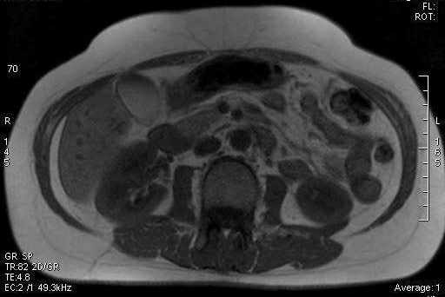
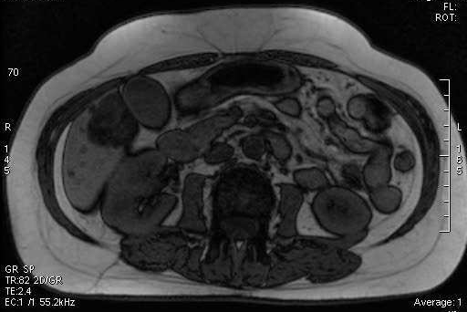
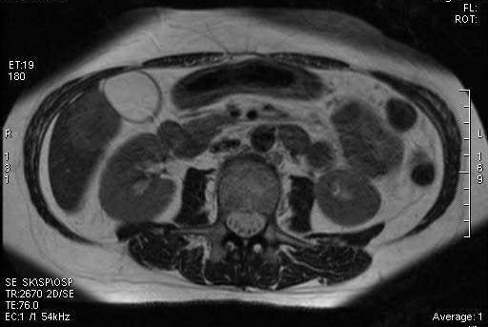

Slide 24
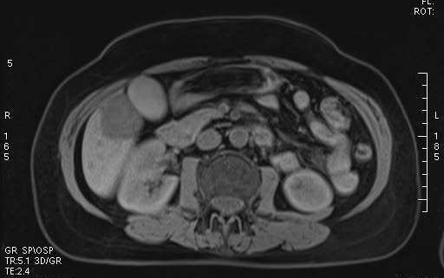
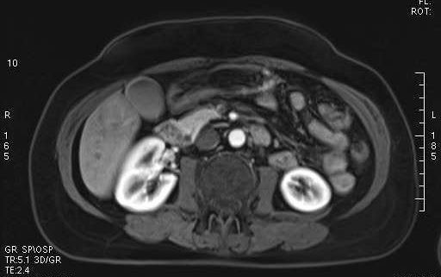
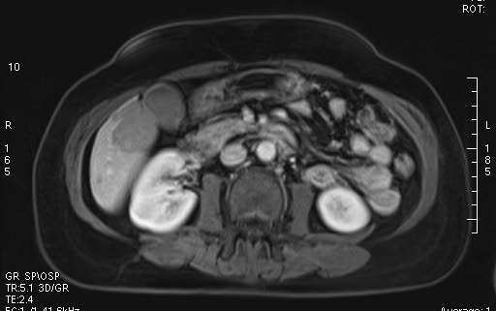
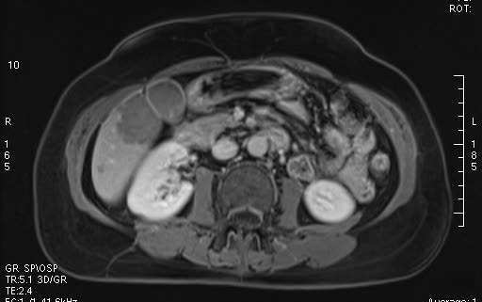
HNF1α mutated adenoma

Slide 25
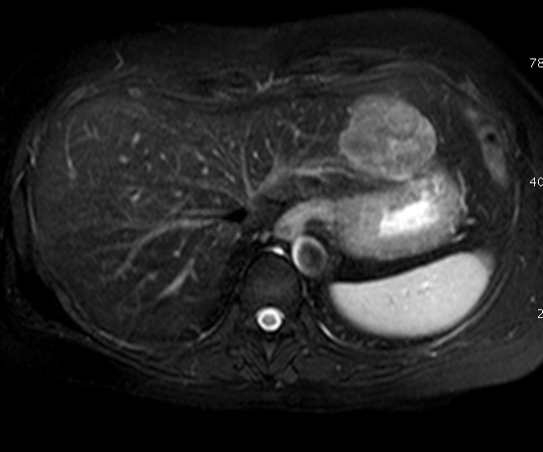
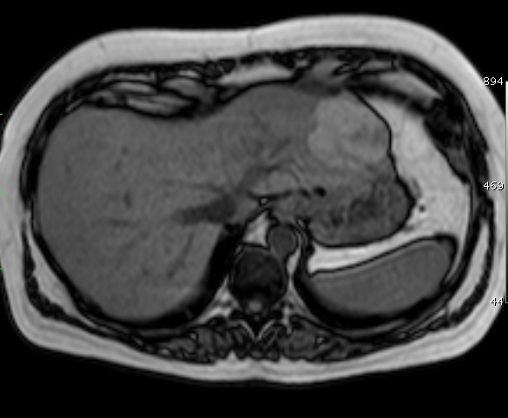
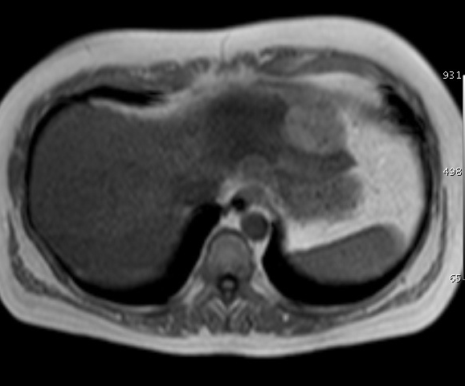
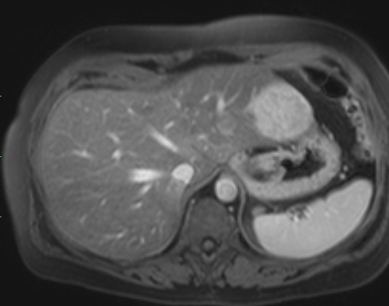
Inflammatory adenoma
Notes:
CHOLLOT

Slide 26
Liver MRI
Hemangioma
Typical FNH
« Atypical » FNH
Adenoma
Steatotic adenoma (HNF1αmutated)
Inflammatory adenoma
MRI with hepatospecific contrast agent
CEUS
Stop
Stop
Non specific adenoma
Biopsy
Male sex
or
βcatenin
→ resection
Stop oral contraception
Multidisciplinary meeting
Follow up
> 5 cm → Resection

